Slide 1
data science with python
Overview & Framework

Slide 2
Data Science Overview
Organization interest in Data science/ML/Python
Core spaces of DS, AI, ML, DL
BIG DATA definition, Evolution, drivers
V’s of BIG DATA
BIG DATA - Frameworks
Understanding data science - framework
Roles, skills

Slide 3
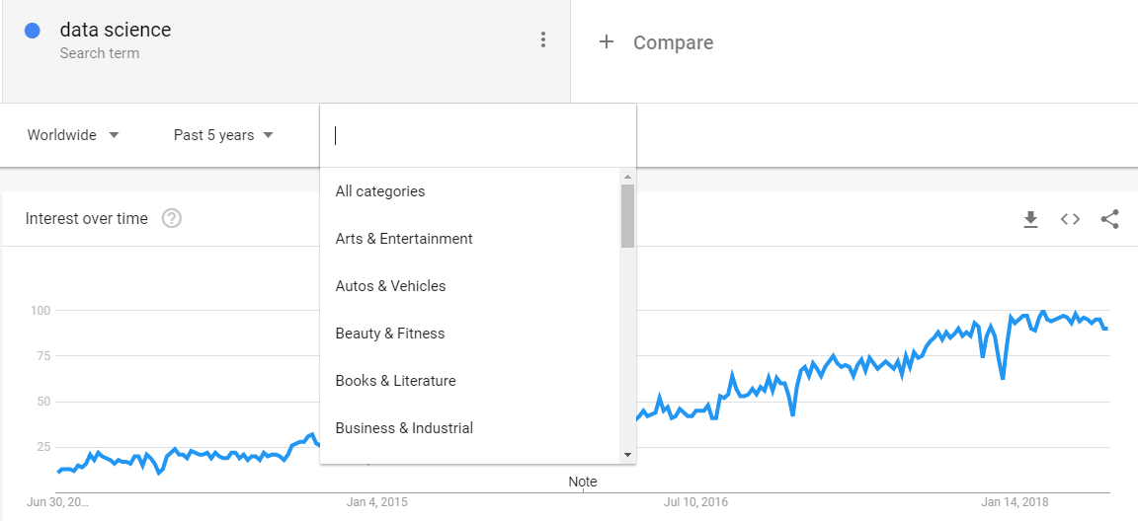
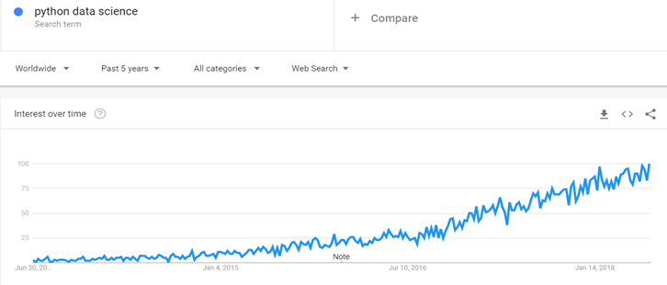
data science today
Data Science is becoming a fundamental way of understanding the world around us, which is based on data.
And data is being generated in huge volume and variety of formats, leading to a formal of technology framework of BIG DATA.
Notes:
Why is everyone talking about DATA SCIENCE? Last 5 years of trend on google search gives a clear picture. Industry/companies/organization/academic institutions are searching more and more of “data science” and “python”.
Am sure, all of you have heard about “data science” and/or “python/R/Spark/Hadoop/Kafka/.. Etc” and have some idea about these terms.
History of DS – it goes back to early 2000s .. 2004 when Google’s search engine was making a huge impact on the way we surfed the web. The reason for big data projects of Google is apparently linked to our increasing dependence on ‘data driven way of living’
When people talk of “data science” , they are in fact talking of companies like Google, Facebook, Twitter, Instagram etc.

Slide 4
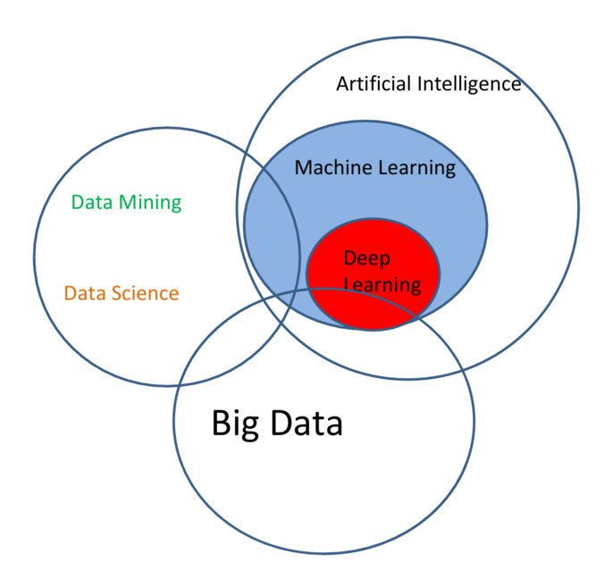
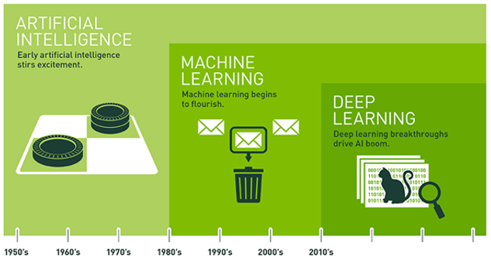
Core spaces
Human Intelligence Exhibited by Machines
An Approach to Achieve Artificial Intelligence
A Technique for Implementing Machine Learning
Machine learning (ML) is the motor that drives data science. Each ML method (also called an algorithm) takes in data, turns it over, and spits out an answer.

Slide 5
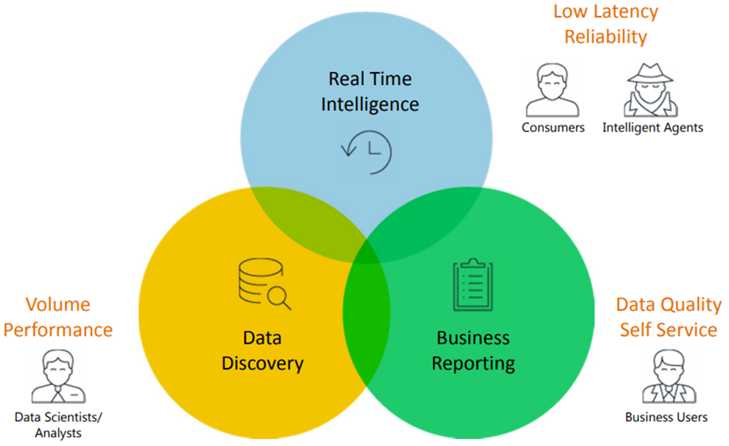
Big data – what is it?
Big data analytics allows data scientists and various other users to evaluate large volumes of transaction data and other data sources that traditional business systems would be unable to tackle.
Big Data Analytics – Use cases

Slide 6
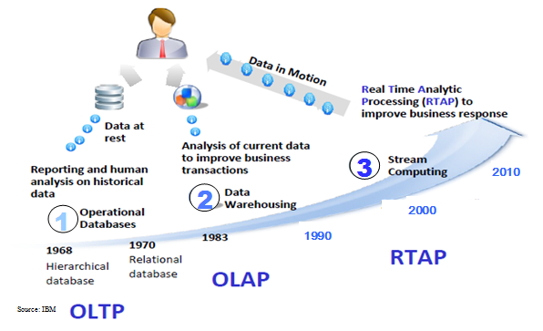
Big data - evolution
OLTP:
Online Transaction Processing
(DBMSs)
OLAP:
Online Analytical Processing
(DW, Data marts)
RTAP:
Real-Time Analytics Processing
(Big Data)

Slide 7
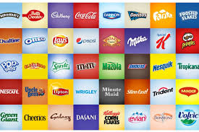
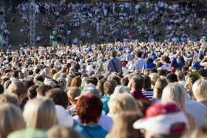

What has changed?
Old Model:
Few companies are generating data, all others are consuming data
New Model:
All of us are generating data, and all of us are consuming data

Slide 8
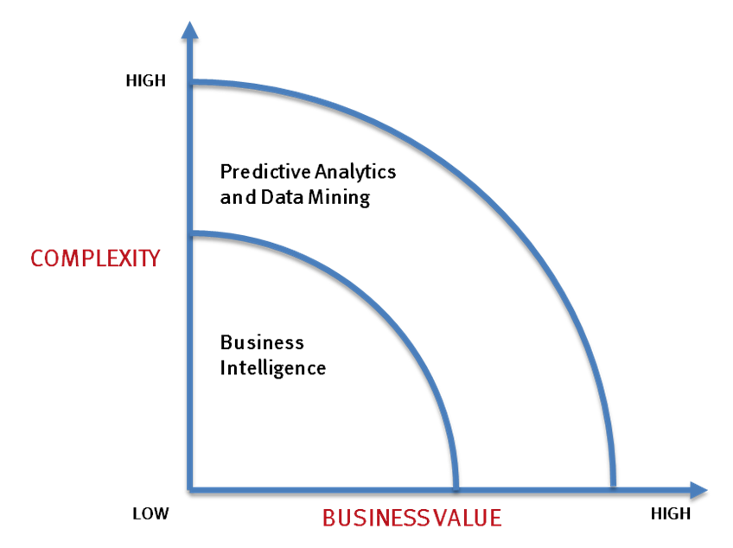
What’s driving Big Data
Optimizations and predictive analytics
Complex statistical analysis
All types of data, and many sources
Very large datasets
More of a real-time
Ad-hoc querying and reporting
Data mining techniques
Structured data, typical sources
Small to mid-size datasets

Slide 9
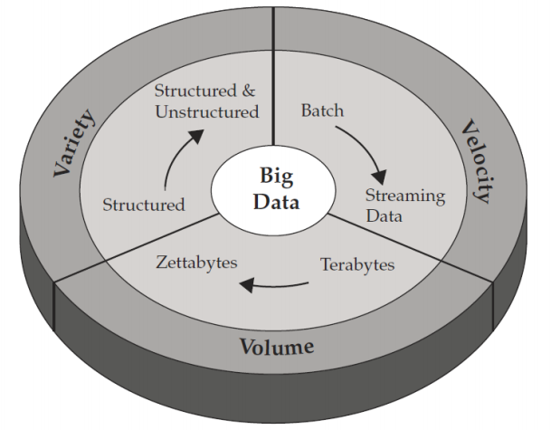

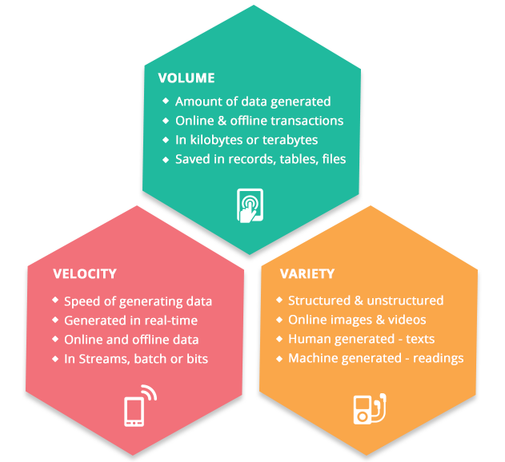
Big data and 3v’s

Slide 10
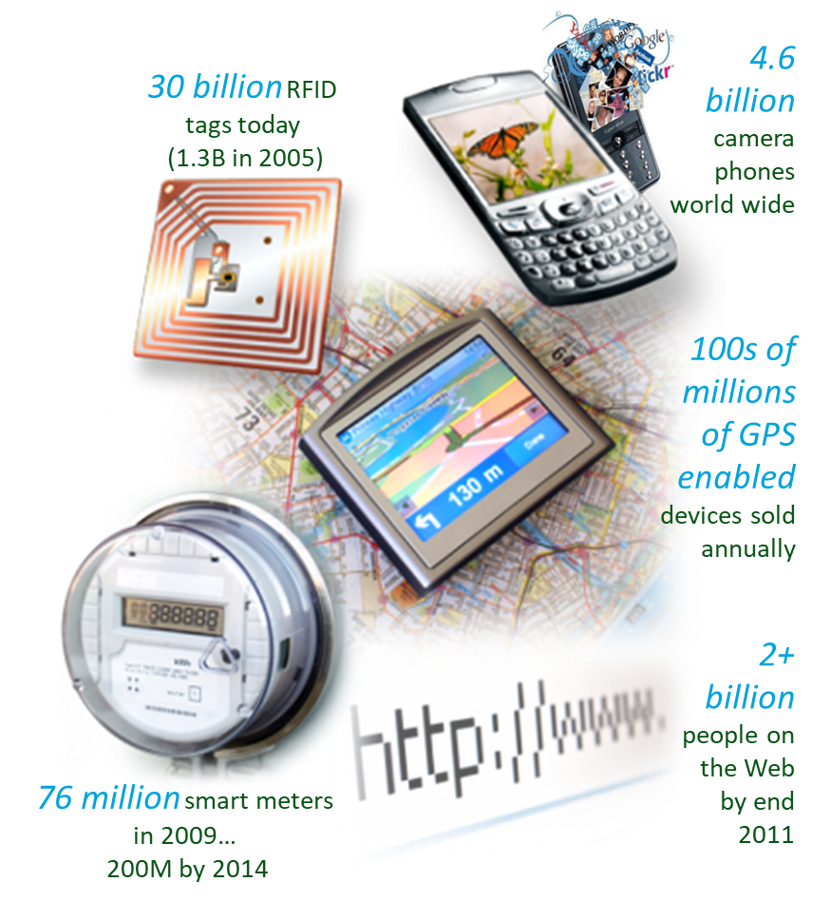
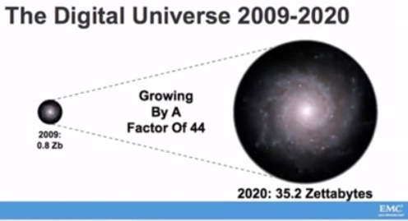
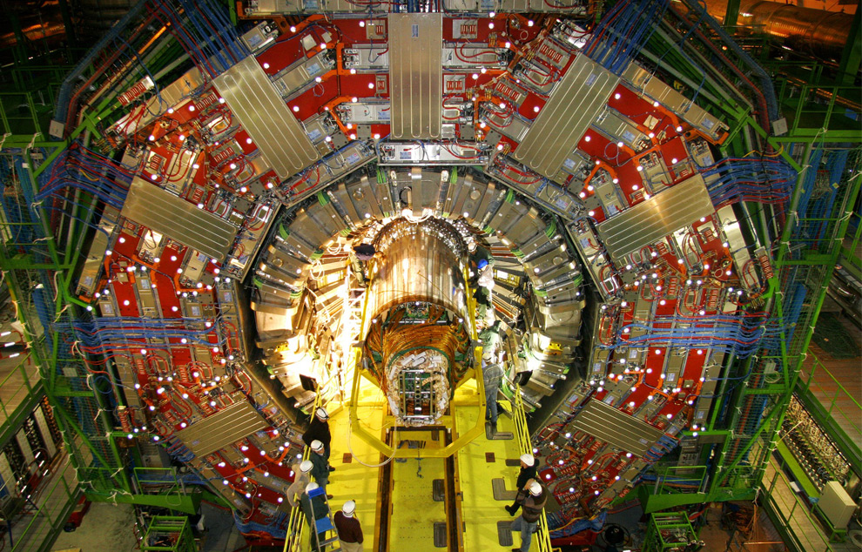

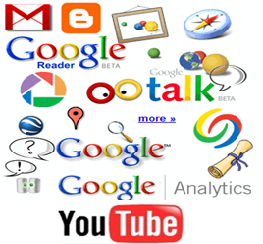
Volume
Facebook,
roughly 250 billion images,
350 million pictures are uploaded every day.
2.5 trillion posts.
2 billion searches per day
1.8 million likes / min
200,000 photos / min
Youtube
1.3 million views / min
72 hours of video uploads / min
Google
One Google search uses the computing power of the entire Apollo space mission.
Twitter
- 12+ TB of tweets/day
MB → GB → TB → PB → EB → ZB
CERN’s Large Hydron Collider (LHC) generates 15 PB a year
Notes:
- All enterprises have SM presence today. SM data very crucial to the enterprises for capturing data from the market and adjusting their production and marketing plans.

Slide 11
Velocity
Data velocity is the speed at which data is received and processed.
Real-Time - Data is processed close to the time that it is input or needed. This implies that you are processing data fast enough to respond to events as they occur. E.g., a customer submits an application for a credit card and you approve it within a few seconds such that they immediately get an answer.
Near Real-Time - Data is processed as events occur but not fast enough to respond immediately. E.g., , a customer submits a credit card application and you immediately begin a process of evaluating the application such that customers often get an answer within an hour.
Batch Data is processed when computing resources are available such that processing falls behind events and catches up. E.g., a social media site that runs algorithms to look for policy violations whenever computing power is free.
Analytical Processing - Processing that is tied to decision making as opposed to business processes and events. This can be done in real-time or near real-time such that decision makers can explore data with analytical tools.
E-Promotions: Based on your current location, your purchase history, what you like → send promotions right now for store next to you
Healthcare monitoring: sensors monitoring your activities and body → any abnormal measurements require immediate reaction

Slide 12
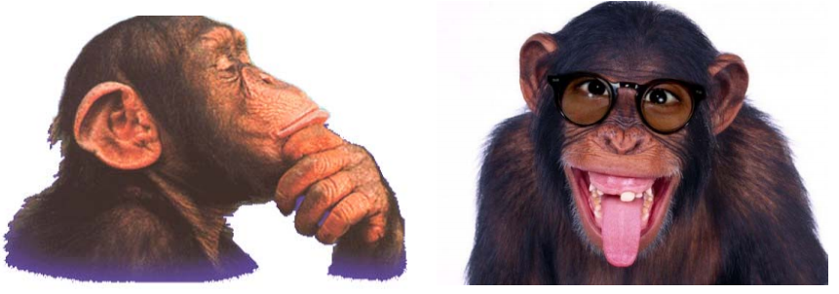
variety
Relational Data (Tables/Transaction/Legacy Data)
Text Data (Web)
Semi-structured Data (XML/YAML)
Graph Data
Social Network, Semantic Web (RDF), …
Streaming Data
Big Public Data (online, weather, finance, etc.)
Rational
Predictable
Traditional
• Agile
• Flexible
• Modern

Slide 13
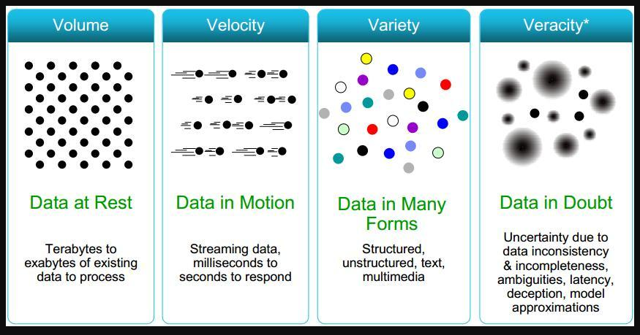
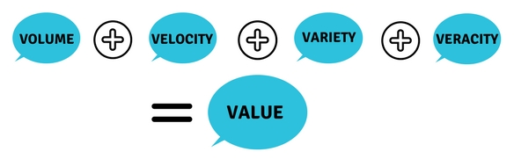
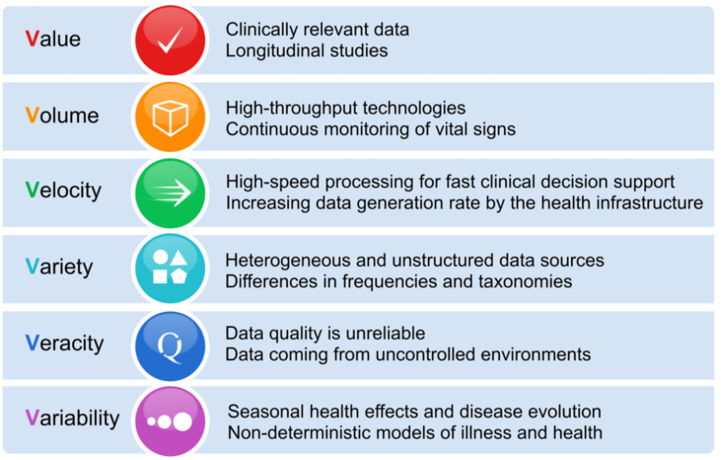
More v’s

Slide 14
veracity
refers to the messiness or trustworthiness of the data.
With volume/velocity/variety, the “quality and accuracy” are less controllable
Twitter posts with hash tags, abbreviations, typos and colloquial speech as well as the reliability and accuracy of content, biases, sarcasm

Slide 15
value
another V to take into account when looking at Big Data: Value!
It is all well and good having access to big data but unless we can turn it into value it is useless.
'value' is the most important V of Big Data.
It is important that businesses make a business case for any attempt to collect and leverage big data.

Slide 16
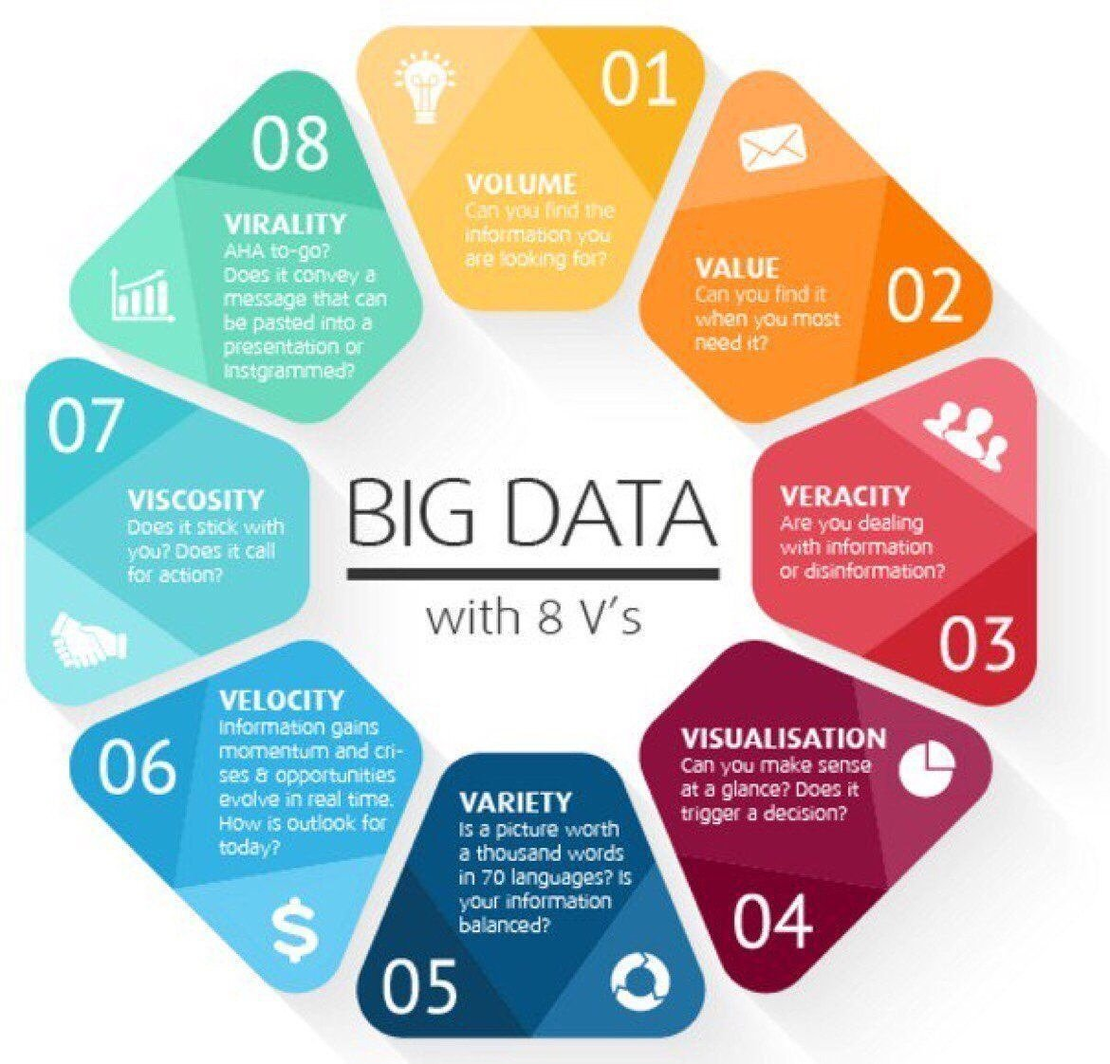
8 V’s

Slide 17
Big data analytics
 | Traditional Analytics (BI) | Big Data Analytics
Focus on | Descriptive analytics Diagnosis analytics | Predictive analytics Prescriptive analytics
Data Sets | Limited data sets Cleansed data Simple models | Large scale data sets More types of data Raw data Complex data models
Supports | Causation: what happened and why? | Correlation: new insights, More accurate answers

Slide 18
Big Data Processing Frameworks
Processing frameworks and processing engines are responsible for computing in a data system.
No authoritative definition on "frameworks“
Generally, categorized into
Batch processing systems
Stream Processing Systems
Hybrid Processing Systems: Batch and Stream

Slide 19
Big Data Processing Frameworks
Batch processing | Stream processing | Hybrid
Involves operating over a large, static dataset and returning the result at a later time when the computation is complete | Compute or execute operations over data as it enters the system. | can handle both batch and stream workloads
The datasets bounded, persistent, large & historical. | The datasets unbounded, continuously arriving.
calculating totals and averages | is good fit when you must respond to changes or spikes near real-time processing Low latency
Apache Hadoop, mapReduce | Apache Storm, Trident Apache Samza, Apache Kafka | Apache Spark Apache Flink

Slide 20
Big data technology stack
The big data ecosystem is just too large, complex and redundant.
too many layers in the technology stack.
too many standards.
too many engines.
too many vendors.
alienates customers,
inhibits funding of customer projects, and
The industry is in the beginning and consolidation will happen.

Slide 21
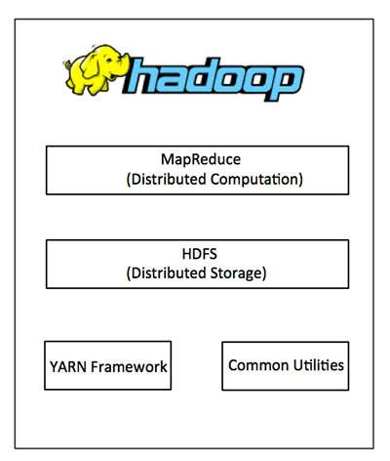
Hadoop
Hadoop is an open-source software framework for storing data & running applications on clusters of commodity hardware.
is named after the two basic operations this module carries out - reading data from the database, putting it into a format suitable for analysis (map), and performing mathematical operations i.e counting the number of males aged 30+ in a customer database (reduce).
provides a distributed file system that is designed to run on large clusters (thousands of computers) of small computer machines in a reliable, fault-tolerant manner.
provides the tools (in Java) needed for the user's computer systems (Windows, Unix or whatever) to read data stored under the Hadoop file system.
manages resources of the systems storing the data and running the analysis.
Fun Fact: "Hadoop” was the name of a yellow toy elephant owned by one of its inventors son.

Slide 22
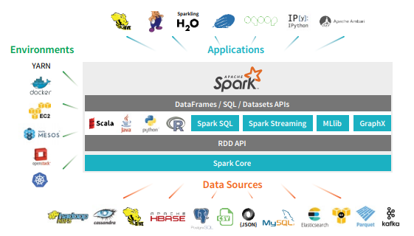
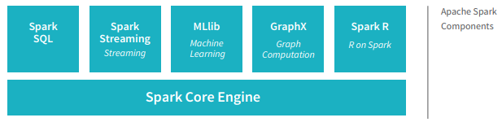
Apache spark

Slide 23
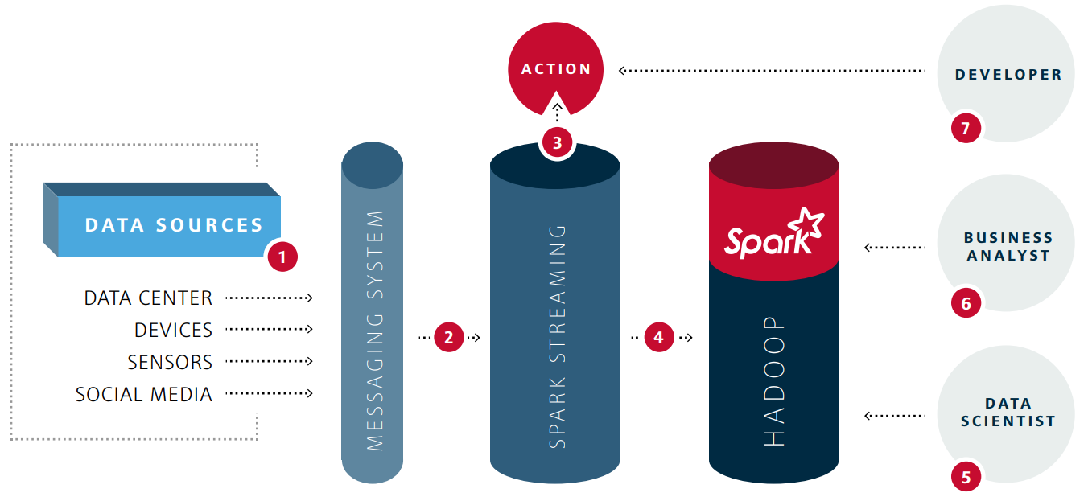
Spark in a Hadoop
1. Data sources are organized into a queue by a messaging system for processing.
7. Developers process the data using Spark APIs and implement new
applications using Java/Scala/python
2. Spark streaming processes the incoming streams in memory,
performing aggregations, counts, and simple checks.
6. Business Analysts can use Spark components for interactive
analytics & reporting.
5. Data Scientists create models based on the data stored on Hadoop
with tools like MLlib or GraphX and can use Python libraries as
well.
3. Operation dashboard input is triggered based on the processed stream data
4. Data is then moved from inmemory streams to a Hadoop cluster for largescale, reliable storage and downstream analytics. From here different user groups work with the data.

Slide 24
Data science Defined
Data Science is the art of turning data into actions.
Accomplished through the creation of data products, which provide actionable information
Examples include:
• Movie Recommendations
• Weather Forecasts
• Stock Market Predictions
• Production Process Improvements
• Health Diagnosis
• Flu Trend Predictions
• Targeted Advertising

Slide 25
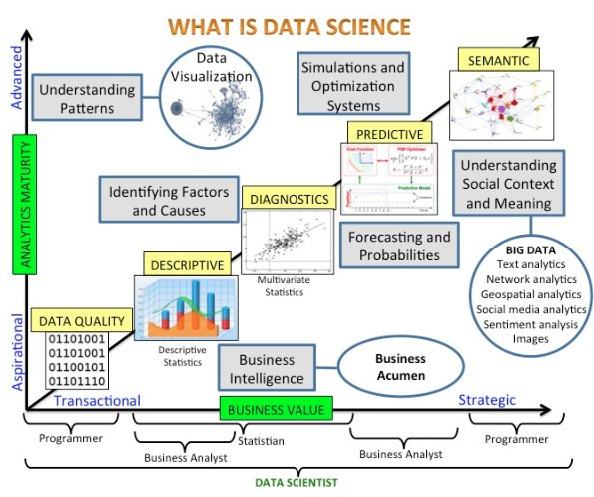
Data science – What makes it Different?
Data Science supports and encourages shifting between deductive (hypothesis-based) and inductive (pattern-based) reasoning.
This is a fundamental change from traditional analytic approaches.
Inductive reasoning and exploratory data analysis provide a means to form or refine hypotheses and discover new analytic paths.
the interplay between inductive and deductive reasoning.

Slide 26
THE TYPES OF REASON…
DEDUCTIVE REASONING | INDUCTIVE REASONING
Commonly associated with “formal logic.” | Commonly known as “informal logic,” or “everyday argument.”
Involves reasoning from known premises, or premises presumed to be true, to a certain conclusion. | Involves drawing uncertain inferences, based on probabilistic reasoning.
The conclusions reached are certain, inevitable, inescapable | The conclusions reached are probable, reasonable, plausible, believable.

Slide 27
Data science is
is a complex field.
It is difficult
intellectually taxing work,
requires sophisticated integration of talent, tools and techniques.

Slide 28
THE TYPES OF REASON…and their roles
DEDUCTIVE REASONING | INDUCTIVE REASONING
Formulate hypotheses about relationships and underlying models. | Exploratory data analysis to discover or refine hypotheses.
Carry out experiments with the data to test hypotheses and models. | Discover new relationships, insights and analytic paths from the data.

Slide 29
Data science and business intelligence
Key contrasts include:
›› Discovery vs. Pre-canned Questions:
Data Science actually works on discovering the question to ask as opposed to just asking it.
›› Power of Many vs. Ability of One: An entire team provides a common forum for pulling together computer science, mathematics and domain expertise.
›› Prospective vs. Retrospective:
Data Science is focused on obtaining actionable information from data as opposed to reporting historical facts.

Slide 30
LOOKING BACKWARD AND FORWARD
FIRST THERE WAS BUSINESS INTELLIGENCE | NOW WE'VE ADDED DATA SCIENCE
Deductive Reasoning | Inductive and Deductive Reasoning
Backward Looking | Forward Looking
Slice and Dice Data | Interact with Data
Warehoused and Siloed Data | Distributed, Real Time Data
Analyze the Past, Guess the Future | Predict and Advise
Creates Reports | Creates Data Products
Analytic Output | Answer Questions and Create New Ones
 | Actionable Answer

Slide 31
Data Science (roles)
Stats/ Algorithms
Programming
Communications
Data Czar
Hacker
Python/R/ Spark/ Big Data/ No SQL core team
BUSINESS
Stats Prof
IT guy
Accountant/ CA
Hot Air !!
Data Scientist
Consultant
Expected Data Scientist
Computer Sc Prof
Number cruncher
IT Head
Analyst
Marketing/ Sales

Slide 32
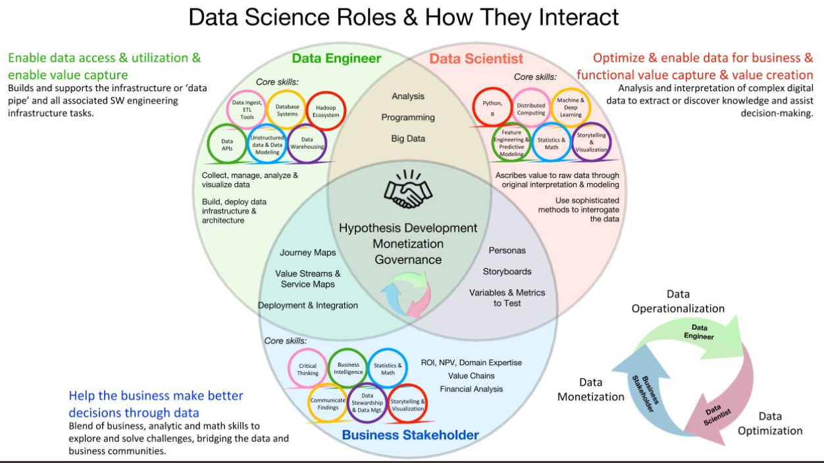
Data Science role

Slide 33
Data science - framework

Slide 34
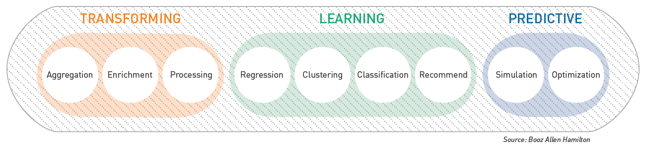
Classes of Analytic Techniques
Membership in a class simply indicates a similar analytic function.
The 9 analytic classes are shown in the figure, Classes of Analytic Techniques.

Slide 35
Transforming Analytics
Aggregation:
Techniques to summarize the data.
These include basic statistics (e.g., mean, standard deviation), distribution fitting, and graphical plotting.
Enrichment:
Techniques for adding additional information to the data, such as source information or other labels.
Processing:
Techniques that address data cleaning, preparation and separation.
This group also includes common algorithm pre-processing activities such as transformations and feature extraction.

Slide 36
Learning Analytics
Regression:
Techniques for estimating relationships among variables, including understanding which variables are important in predicting future values.
Clustering:
Techniques to segment the data into naturally similar groups.
Classification:
Techniques to identify data element group membership.
Recommendation:
Techniques to predict the rating or preference for a new entity, based on historic preference or behavior.

Slide 37
Predictive Analytics
Simulation:
Techniques to imitate the operation of a real world process or system.
These are useful for predicting behavior under new conditions.
Optimization:
Operations Research techniques focused on selecting the best element from a set of available alternatives to maximize a utility function.

Slide 38
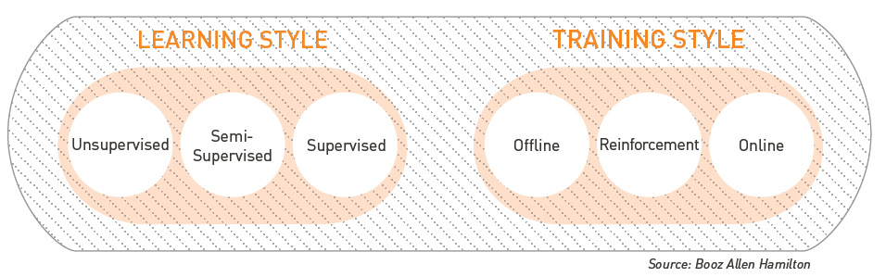
Learning Models
Analytic classes that perform predictions, such as regression, clustering, classification and recommendation employ learning models.
These models characterize how the analytic is trained to perform judgments on new data based on historic observation.

Slide 39
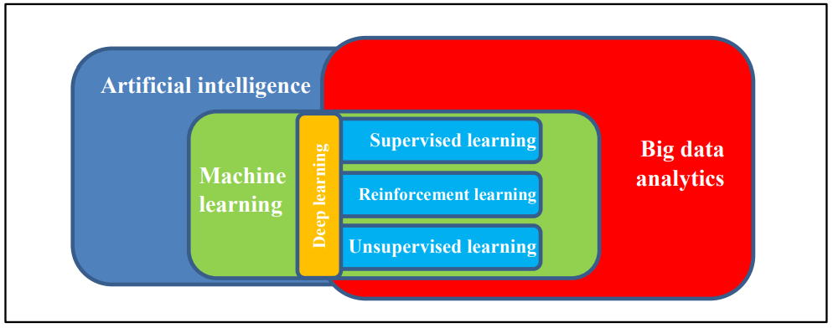
Learning models - categories
unsupervised or supervised learning.
Supervised learning takes place when a model is trained using a labeled dataset that has a known class or category associated with each data element.
Unsupervised learning involves no a-priori knowledge about the classes into which data can be placed.
Unsupervised learning uses the features in the dataset to form groupings based on feature similarity.

Slide 40
train learning models
Offline
trained in a single pass
Online
trained incrementally over time
Entire training dataset is needed
models are static in that once trained, their predictions will not change until a new model is created through a subsequent training stage
performance is easier to evaluate due to this deterministic behavior
dynamically evolves over time
New deployments needed
require a single deployment into a production setting
Do not have entire dataset while being trained – is a challenge
One such training style is known as Reinforcement Learning (refer Deep learning)

Slide 41
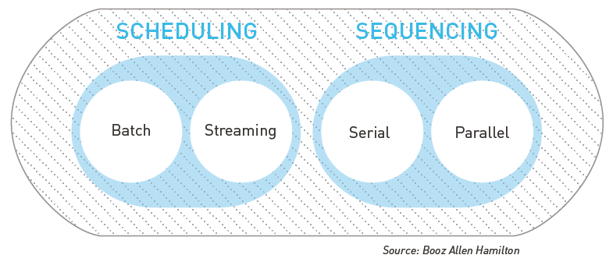
Execution Models
The choice between batch and streaming execution models often
hinges on analytic latency and timeliness requirements.
Latency refers to the amount of time required to analyze a piece of data once it arrives at the system, while timeliness refers to the average age of an answer or result generated by the analytic system.
batch approach - When latency of hours and timeliness of days is acceptable
streaming execution model - analytic goals have up-to-the-second requirements .
Massive server configuration – Serial processing
Clusters of servers – Parallel processing.

Slide 42
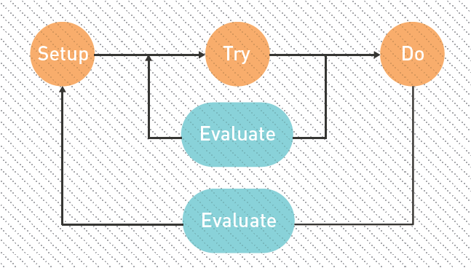
Iterative by Nature
Good Data Science is fractal in time - an iterative process.
Getting an imperfect solution out the door quickly will gain more interest from stakeholders than a perfect solution that is never completed.

Slide 43
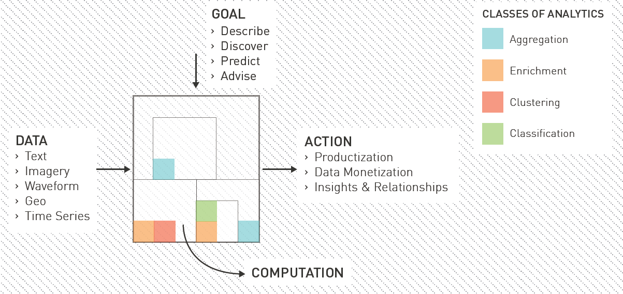
Data science – big picture
GOAL
Is it to Discover, Describe, Predict, or Advise?
It is probably a combination of several of those
DATA
collect that data through carefully planned variations
A/B testing or design of experiments.
Datasets are never perfect
COMPUTATION
computation decomposes into several smaller analytic capabilities
Layered evolution – e.g. onion/ broccoli

Slide 44
Decomposing the Problem
“If you focus only on the science aspect of Data Science you will never become a data artist.”
A critical step in Data Science is to identify an analytic technique that will produce the desired action.
Sometimes it is clear; a characteristic of the problem (e.g., data type) points to the technique you should implement.
Other times, however, it can be difficult to know where to begin !!!
The universe of possible analytic techniques is large.
Finding your way through this universe is an art that must be practiced.

Slide 45
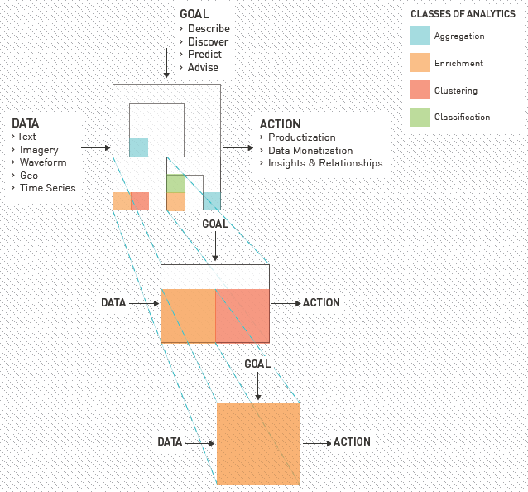
Fractal Analytic Model
Fractal Analytic Model embodies
collection of smaller computations that decompose into yet smaller computations.
When the problem is decomposed far enough, only a single analytic technique is needed to achieve the analytic goal.
Problem decomposition creates multiple sub-problems, each with their own goals, data, computations and actions.

Slide 46
Art or engineering?
On the surface, problem decomposition appears to be a mechanical, repeatable process.
Conceptually true but it is really the performance of an art as opposed to the solving of an engineering problem.
May be many valid ways to decompose the problem, each leading to a different solution.
Hidden dependencies or constraints only emerge after we begin developing a solution.
This is where art meets science.
The art behind problem decomposition cannot be taught ☹

Slide 47
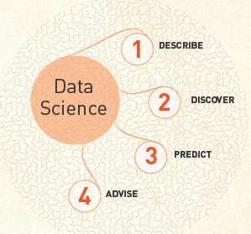
Analytic Selection
The universe of analytic techniques is vast and hard to comprehend, without a documented map.

Slide 48

Summary – what questions data science answers?
Is this A or B?
This is formally known as two-class classification. It’s useful for any question that has just two possible answers: yes or no, on or off, smoking or non-smoking, purchased or not. Here are few typical examples. Will this customer renew his/her subscription? Is this an image of a cat or a dog? Will this customer click on the top link? Will this tyre fail in the next thousand miles? Does the RS. 5 coupon or the 25% off coupon result in more return customers?

Slide 49
Summary – what questions data science answers?
Is this A or B or C or D?
Also called multi-class classification. it answers a question that has several (or even many) possible answers: which flavor, which person, which part, which company, which candidate. Here are a few typical examples. Which animal is in this image? Which aircraft is causing this radar signature? What is the topic of this news article? What is the mood of this tweet? Who is the speaker in this recording?

Slide 50
Summary – what questions data science answers?
Is this bizarre, weird or uncommon?
Known as anomaly detection. They identify data points that are not normal. this looks like a binary classification question. It can be answered yes or no. The difference is that binary classification assumes you have a collection of examples of both yes and no cases. Anomaly detection doesn’t. Here are some typical anomaly detection questions. credit card fraud detection. Is this pressure reading unusual? Is this combination of purchases very different from what this customer has made in the past? Are these voltages normal for this season and time of day?

Slide 51

Summary – what questions data science answers?
How Much / How Many?
When you are looking for a number instead of a class or category, the algorithm family to use is regression. What will the temperature be next Tuesday? What will my fourth quarter sales in Kolkata be? How many new followers will I get next week? Out of a thousand units, how many of this model of bearings will survive 10,000 hours of use?

Slide 52
Summary – what questions data science answers?
Multi-Class Classification as Regression
Questions of this type often occur as rankings or comparisons. “Which car in my fleet needs servicing the most?” can be rephrased as “How badly does each car in my fleet need servicing?” “Which 5% of my customers will leave my business for a competitor in the next year?” can be rephrased as “How likely is each of my customers to leave my business for a competitor in the next year?”

Slide 53
Summary – what questions data science answers?
Two-Class Classification as Regression
Questions of this type often begin “How likely…” or “What fraction…” How likely is this user to click on my ad? What fraction of pulls on this lottery machine result in payout? How likely is this employee to be an insider security threat? What fraction of today’s flights will depart on time?

Slide 54

Summary – what questions data science answers?
How is this Data Organized?
Questions about how data is organized belong to unsupervised learning. Which shoppers have similar tastes in produce? Which viewers like the same kind of movies? Which printer models fail the same way? During which days of the week does this electrical substation have similar electrical power demands? What is a natural way to break these documents into five topic groups?

Slide 55
Summary – what questions data science answers?
What Should I Do Now?
called reinforcement learning (RL) algorithms. different than the supervised and unsupervised learning algorithms. A regression algorithm might predict that the high temperature will be 98 degrees it doesn’t decide what to do about it. A RL algorithm goes the next step and chooses an action, such as pre-refrigerating the upper floors of the office building while the day is still cool. RL algorithms were originally inspired by how the brains of rats and humans respond to punishment and rewards. They choose actions, trying very hard to choose the action that will earn the greatest reward.

Slide 56
Summary – what questions data science answers?
What Should I Do Now?
Where should I place this ad on the webpage so that the viewer is most likely to click it? Should I adjust the temperature higher, lower, or leave it where it is? Should I vacuum the living room again or stay plugged in to my charging station? How many shares of this stock should I buy right now? Should I continue driving at the same speed, brake, or accelerate in response to that yellow light?

Slide 57
Misc slides

Slide 58
Data Science Goals and Deliverables
Prediction (predict a value based on inputs)
Classification (e.g., spam or not spam)
Recommendations (e.g., Amazon and Netflix recommendations)
Pattern detection and grouping (e.g., classification without known classes)
Anomaly detection (e.g., fraud detection)
Recognition (image, text, audio, video, facial, …)
Actionable insights (via dashboards, reports, visualizations, …)
Automated processes and decision-making (e.g., credit card approval)
Scoring and ranking (e.g., FICO score)
Segmentation (e.g., demographic-based marketing)
Optimization (e.g., risk management)
Forecasts (e.g., sales and revenue)

Slide 59
application
It covers all industries and fields, but especially
digital analytics,
search technology,
marketing,
fraud detection,
astronomy,
energy,
healthcare,
social networks,
finance,
forensics,
security (NSA),
mobile,
telecommunications,
weather forecasts

Slide 60
Data science - projects
Projects include
taxonomy creation (text mining, big data),
clustering applied to big data sets,
recommendation engines,
simulations,
rule systems for statistical scoring engines,
root cause analysis,
automated bidding,
forensics, exo-planets detection, and early detection of terrorist activity or pandemics
An important component of data science is
automation,
machine-to-machine communications,
as well as algorithms running non-stop in production mode (sometimes in real time), for instance to detect fraud, predict weather

Slide 61
job titles
Job titles include
data scientist,
chief scientist,
senior analyst,
director of analytics
and many more.

Slide 62
profiles
Summary:-
R (53%) and Python (53%) are the programming languages that dominate the data science field.
Other popular languages are SQL (40%), MATLAB (19%), Java (18%), and C/C++ (18%)
58% of the data scientists come from one of three educational backgrounds:
Computer science (20%),
Statistics and Mathematics (19%),
and Economics and Social Sciences (19%).
The leading employer for data scientists is the
Tech industry (42%),
Industrial Sector (37%) following closely by.
Financial sector account for 16%
Healthcare industries account for 5% of data scientists

Slide 63
disciplines
Computer science: computational complexity, Internet topology and graph theory, distributed architectures such as Hadoop, data plumbing (optimization of data flows and in-memory analytics), data compression, computer programming (Python, Perl, R) and processing sensor and streaming data from IOT/M2M devices
Statistics: design of experiments including multivariate testing, cross-validation, stochastic processes, sampling, model-free confidence intervals
Machine learning and data mining: data science indeed fully encompasses these two domains.
Operations research: data science encompasses most of operations research as well as any techniques aimed at optimizing decisions based on analyzing data.
Domain/ Business intelligence: every BI aspect of designing/creating/identifying great metrics and KPI's, creating database schemas (be it NoSQL or not), dashboard design and visuals, and data-driven strategies to optimize decisions and ROI

